Slide 1
Exploring student engagement with academic staff
Workshop One
Understanding the student learning experience.
Editable slide pack.

Slide 2
Understanding the student learning experience
Student-staff discussion workshop.
Course name here
XX Month 2021

Slide 3
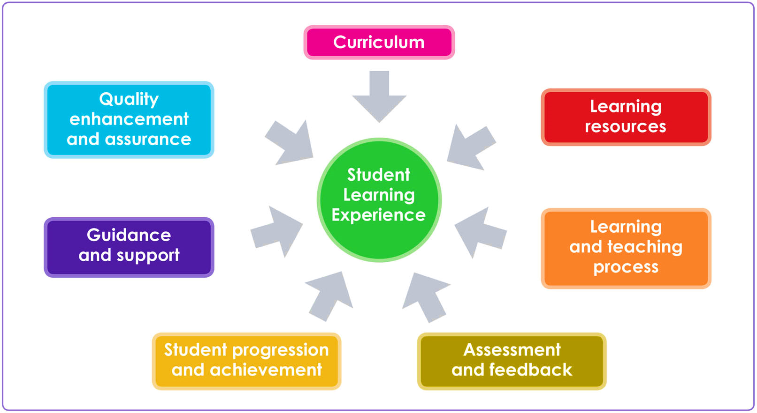
The Student Learning Experience
Notes:
Introduce this by asking the whole group to come up with ideas about they understand by all of the headings on the SLE – Curriculum, Learning Resources, Learning and Teaching Process etc.

Slide 4
Curriculum
Items relevant to Curriculum include:
Course content.
Handbooks.
Study abroad opportunities.
Placements.
Optional and compulsory modules.

Slide 5
Discussion
1. Do the course and module objectives match your expectations from the information given to you before you started?
Student experience of… Curriculum
2. Does the course content reflect the changes that have taken place in your related industry as a result of COVID-19?
3. What do you think about the module choices that were offered, and the order of delivery?

Slide 6
Learning Resources
Items relevant to Learning Resources include:
The library.
IT facilities and software.
VLE (such as Canvas or Moodle).
Classroom resources and other campus facilities.

Slide 7
Discussion
1. Are you supported to use learning technology, including any technologies for studying online?
Student experience of… Learning Resources
2. If you are not able to access the library on campus, are staff supporting you to access appropriate equivalent learning materials online?
3. Have you been supported to access subject-specific facilities in a COVID-safe way (e.g. labs, studios, theatres, computing rooms, etc.). Or have alternatives been provided?

Slide 8
Learning and Teaching Process
Items relevant to Learning and Teaching Process include:
Contact time, including both synchronous and asynchronous, and online and in-person
Independent and group work
Class sizes
Teaching styles
Staff development
Notes:
The range of teaching methods that are used? Lectures, tutorials, practical work, labs, group work.
Is it the right method for the kind of course? Is there a good balance of theory work and practical activity?
Is it accessible?

Slide 9
Discussion
1. How have you found the transition to online teaching? In which ways have staff made this transition easier? Is there anything you would have preferred done differently?
Student experience of… Learning and Teaching Process
2. If you have been learning in an online environment, have you been given tasks that involve learning off-screen?
3. Are there any parts of your course that have not been well covered by the move to online teaching?

Slide 10
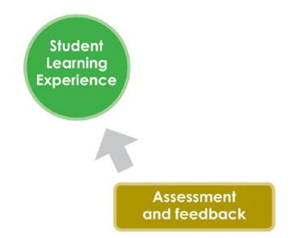
Assessment and Feedback
Items relevant to Assessment and Feedback include:
Marking criteria
Consistency of marking
Number and type of assessments
Choice of assessment
Quality and promptness of feedback

Slide 11
Discussion
1. Has your course been assessed in a different way as a result of the pandemic, e.g. no practical assessments? Have alternative assessments been adequate at measuring your learning?
Student experience of… Assessment and Feedback
2. Did you receive clear guidance from your department relating to how assessments would be run during COVID-19 and, especially, to any changes in assessments?
3. Have you experienced any barriers to engaging in assessments?

Slide 12
Student Progression and Achievement
Items relevant to Student Progression and Achievement include:
Induction.
The learner journey.
Links between courses.
Personal development and progression.

Slide 13
Discussion
1. Have you experienced any challenges progressing from one year of your course to the next?
Student experience of… Student Progression and Achievement
2. Have you identified any gaps in your knowledge as a result of missed content due to the impact of COVID-19?
3. Have you had the opportunity to attend induction events, either online or in-person? Did you notice any creative approaches to the delivery or content of these events?

Slide 14
Guidance and Support
Items relevant to Guidance and Support include:
Careers advice.
Personal support.
Counselling.
Academic support.

Slide 15
Discussion
1. Have you been given clear guidance on who you should contact if you need to discuss extensions or apply for special circumstances due to COVID-19-related circumstances?
Student experience of… Guidance and Support
2. Has your institution or department offered a way for you to engage with students and staff informally?
3. How much support do you receive for your academic work?

Slide 16
Quality Enhancement and Assurance
Items relevant to Quality Enhancement and Assurance include:
Conversations about enhancing the learning experience.
The role of course reps.
Teaching observation.
Student surveys.
Interpretation of student feedback.
How students’ ideas are acted on and communicated back.

Slide 17
Discussion
1. Have you had a chance to provide feedback on the changes made to your course directly as a result of COVID-19?
Student experience of… Quality Enhancement and Assurance
2. Have you been given opportunities to feed back to senior staff at your institution on COVID-related issues; e.g. through meetings where students can raise issues directly with senior leaders?
3. Do you feel that you and your classmates’ opinions are listened to and taken seriously?

